Slide 1

Wine Quality Analysis
Different Factors’ Impact on Quality of Wine
Nishit Malkania

Slide 2
Introduction
Dataset Overview
The wine dataset includes features like fixed acidity, volatile acidity,
residual sugar, alcohol, and quality scores ranging from 3 to 8.
Model Used
Most frequent quality is 5, appearing as the mode across samples.
​ Data is split into training/testing sets with StandardScaler for preprocessing.

Slide 3
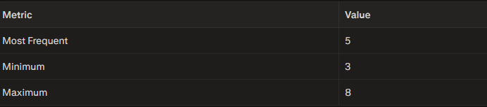
Q1: Finding the most frequently occuring, minimum and maximum quality.
Most Frequently Occuring Wine Quality is: 5
Minimum Wine Quality is: 3
Maximum Wine Quality is: 8

Slide 4
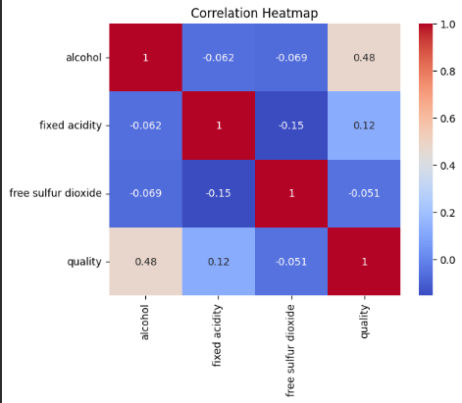
Q2: Finding how 'fixed acidity', 'alcohol content' and 'free sulphur dioxide' is co-related to quality of the wine
Alcohol Content : Correlation = 0.476166
(Positive)
Free Sulphur Dioxide: Correlation = -0.50656 (Negative)
Fixed Acidity: Correlation = 0.124052
(Weak positive)

Slide 5
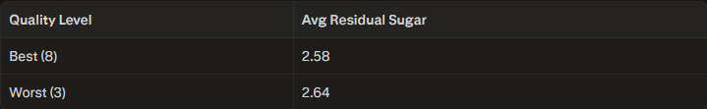
Q3: Finding out average residual sugar in best quality and worst quality wine.
Averages are similar (best: 2.58 g/L, worst: 2.64 g/L), suggesting minimal impact on extremes.

Slide 6
Q4: Affect of Volatile Acidity on Quality of the wine.
Volatile acidity negatively correlates
with quality at -0.39, indicating higher
acidity lowers quality.

Slide 7
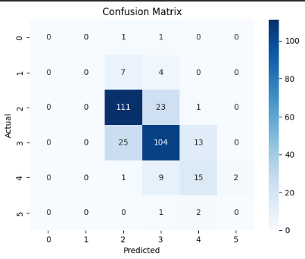
Q4: Linear Regression Model
A Decision Tree Classifier Model and a
Random Forest Classifier Model was trained
on the data to find out which one performs
the best
Model accuracy: R² score indicates
good fit
Predictions visualized against actual values
Confusion Matrix was also visualized

Slide 8
Q5: Sales Prediction
For advertising expenditure of:
TV: $200K, Radio: $40K, Newspaper: $50K
Predicted Sales: Calculated using the trained linear regression model

Slide 9

Result and Final Insights
When Both the models were compared, we found out:
Random Forest is better than Decision Tree
Alcohol and sulphates positively influence quality; volatile acidity harms it
Random Forest (71.9% accuracy) is superior for this classification task.
Residual sugar shows negligible difference between best/worst wines.

Slide 10
Thank You!

